Slide 1
WEEK - 3
Sonam Rinjin Sherpa

Slide 2
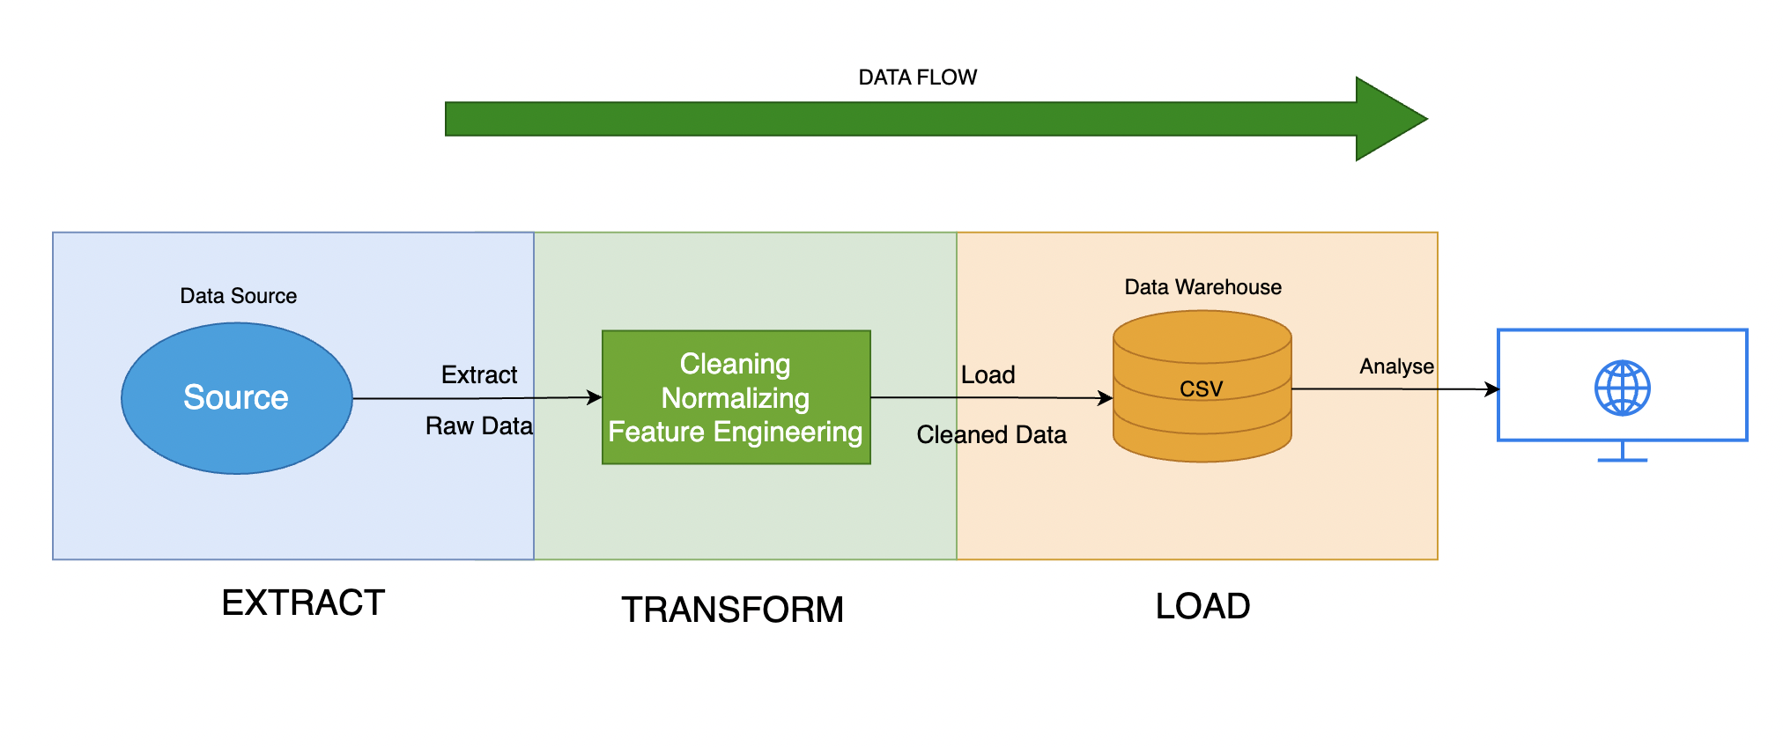
DATA PIPELINE
Notes:
ETL stands for the extraction of data from diverse sources, its transformation into an effective state, and loading it into a destination system (e.g., a data warehouse or database).
It is typically used in data warehousing, business intelligence, and analysis.
The data will be retrieved from the relational database 'MSDS610' we created in the previous week.
The data will be then checked for missing values, duplicates, and outliers. The categorical features will be encoded.
I will also add some new features into the dataset such as income to education ratio, work hour category etc. After the modifications, the new cleaned data will be added to the 'cleaned' schema.
The new data will also be saved in CSV format.
The advantages of ETL are:
Provides data consistency across systems. Improves data quality by cleaning and validating the data. Allows for scalable processing of large volumes of data. Enables business intelligence and analytics through effective data organization.

Slide 3
Pipeline Type – Batch
I chose batch pipeline because
The dataset I have chosen (adult dataset) is a static dataset.
Batch pipeline makes it easier to transform and clean data more efficiently.
The dataset doesn't require real time processing and analysis.
A machine learning model is usually trained with a full dataset rather than real-time data.
Notes:
There are several reasons why I chose batch pipeline for processing the dataset.
Batch pipeline is a process of data processing that collects, processes, and loads data at regular intervals rather than in real time.
It executes tasks based on a schedule, processing high volumes of data at once rather than processing individual items individually in real time.
Firstly, the dataset that I have selected is a static dataset, which means that the dataset does not change frequently, making it easier to process using batch processing.
Another reason why I chose batch processing is because batch pipeline makes data transformation as well as cleaning much more efficient, which is highly necessary for making data quality better for analysis.
As the dataset doesn't require analysis and processing, there is no requirement for a streaming pipeline which is often more complex than batch pipeline.
The machine learning model is generally trained with a complete dataset in a single go, rather than real-time data, which is collected in near real time.
This makes batch processing much more compatible for training a model with it.

Slide 4
DATA FORMAT - CSV
I have chosen CSV because -
It is a readable by human as it is just plain text.
It can be easily modified and manipulated.
The dataset I have chosen is a medium-sized dataset, and CSV fits perfectly.
Easier to process with Python
Notes:
I chose CSV as the file format for the dataset I will be working on as CSV is human readable as it is simple text, this makes it fairly easy to interpret and modify without using special languages or tools.
The columns tend to be delimited by a comma, but other delimiters (like semicolons, tabs) might be used.
CSV files are editable universally and can be manipulated easily.
CSV usually works best with small to medium-sized databases.
As, the dataset that I chose is medium-sized, CSV format works best with it. It does not need more complex format such as databases or JSON.
CSV is easy to edit and process using Python. Analysis of a CSV format dataset is relatively easier in Python for seamless data handling, visualization and even post-processing analysis.

Slide 5
DATA QUALITY ISSUES
NAME | EFFECT | VALIDATION
Null Value | It can lead to biased results Might impact the process of down streaming | df.isull( ).sum( ) - Find sum of null values. Use imputation techniques or remove null values.
Duplicate Value | Inflate the sample size Hamper statistical analysis | duplicate_count = df.duplicated( ).sum( ) Drop the duplicate values.
Categorical Variables | Inconsistent Values Category Imbalance | One-Hot Encoding df = pd.get_dummies(df, columns=['gender', 'education'])
Notes:
There are several quality issues present in the dataset I have chosen. It has missing values, duplicate values as well as categorical variables.
Missing Data: Incomplete records result in incorrect analysis and decision-making. Duplicate Entries: Duplicate data distorts results and takes up storage. Inconsistent Formatting: Structural differences (e.g., date formats) lead to processing errors. Outliers & Anomalies: Erroneous values distort trends and model predictions.
Stale Data: Stale information decreases relevance and reliability.
These issues make the sample size inflated, impacts down streaming process. This results in the trained model become ineffective, and hampers that decision making ability of the model. It can lead to bias results.
To mitigate the missing or null values, I'll find the total number of missing values in each column of the dataset, then use imputation techniques for suitable null values, or remove them if the are of lesser importance. All the duplicate rows will be dropped to remove redundancy. And finally, I will change all the categorical features into numerical features using one-hot encoding.
Removing these issues will make the model to be efficient and accurate.

Slide 6
Data Drift
To tackle data drift, I can
Keep the reference of the initial distributions of important numerical features
Mean, Medain, Mode, Variance
Make it the baseline for comparision
Notes:
Data Drift refers to the change in the structure and statistical characteristics to change the of a data over time. This makes model perform poorly overtime.
Data drift can cause
Model Degradation: Data distribution change diminishes the accuracy of a model over a period of time. Biased Predictions: Input data manipulation can introduce biased or faulty results. Reduced Reliability: Decisions and observations become less reliable. Operational Disturbances: Automated systems do not function, resulting from unintended changes. Maintenance Costs Escalation: Continuous monitoring and retraining.
Data drift is inevitable, however it is manageable. To tackle data drift in the dataset I have chosen, there are some techniques that I have chosen to use.
First, I am going to keep the reference of the initial distribution of the important numerical features. This is come in handy for comparison when I use a new dataset to train the data. I will also keep track of the mean, median, mode and variance of the dataset. Every thing be used as a baseline for comaprison. So, if the distribution for the new dataset is overtly different from the dataset I chose, I can make changes in the ne dataset maybe retrain the model.

Slide 7
Schema Change
To avoid schema change -
Log Mismatches
Make predefined schema as the template for the new datasets.
Discard unexpected data
Notes:
Schema change is another problem that can occur in the dataset I chose, schema change also known as schema drift occurs when the data system changes overtime.
This negatively affects the data quality of a dataset.
• Data Inconsistency: Schema modifications (i.e., new, missing, or modified fields) introduce inconsistencies between previous and new data. • Broken Pipelines: ETL operations may break when there are unexpected schema changes. •Incorrect Analysis: Models and reports may have incorrect or out-of-date structures. • Compliance Problems: Fields are empty and thus regulatory obligations cannot be met. • Higher Maintenance: Constant tuning and maintenance are necessary in order to manage changing schemas.
To tackle schema change I can check if there are any mismatches while adding new data, and log them if present.
I can also make some predefined schema as the template for the new datasets to prevent any new type of feature or datatype to get trained. I am also going to discard the unexpected data, which has no usefulness in training the model.
This will help me keep the model up to date and efficient through out.

Slide 8
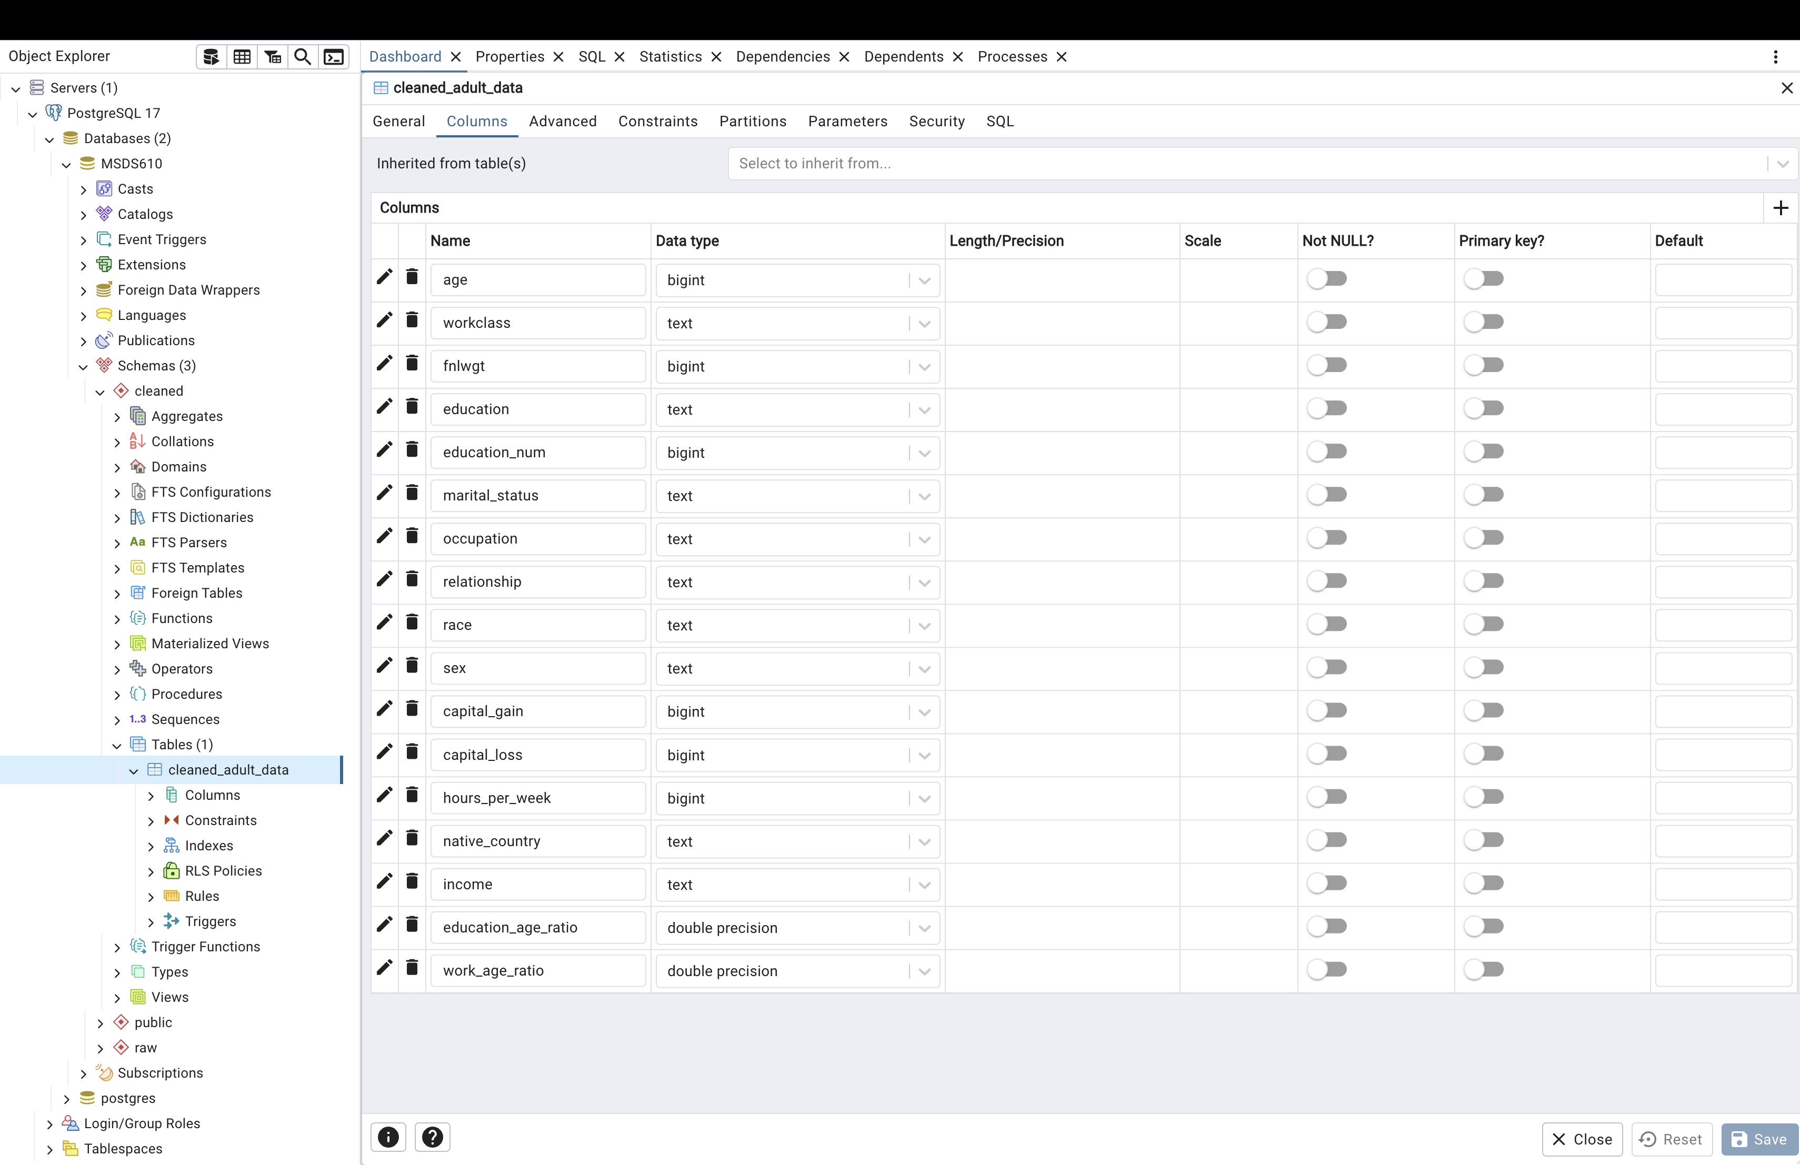
SCREENSHOT
Notes:
This is the screenshot for the cleaned dataset.
There are 17 columns in the new cleaned dataset, with two new addition.
This cleaned dataset has no missing values or duplicates.

Slide 9
THANK YOU

